Slide 1
Confusion matrix?
A confusion matrix is a performance measurement tool for machine learning classification problems.
It shows how well a model’s predictions match the actual classes.
It is especially useful for evaluating binary and multi-class classification models.

Slide 2
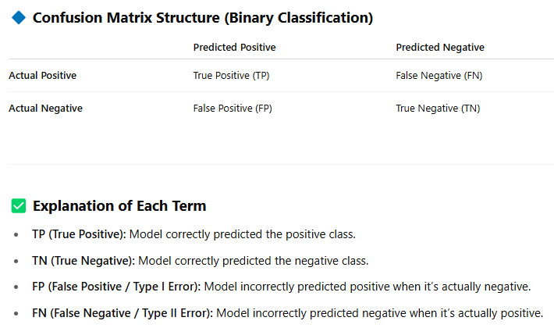

Slide 3
